Slide 1
One Music Ontology
Ontology for Music Analysis
Ghițeanu Andrei-Daniel, ISI

Slide 2
Ontologies and Knowledge Graphs
Ontologies are used to describe concepts, entities and properties of a specific field
Contains the vocabulary and semantic interconnections
The Knowledge Graph is used to represent the instances
Individuals are added to populate the graph
It facilitates the extraction and analysis of information

Slide 3
Main objective
Representing data related to musical elements (notes, pitches, intervals, chords) in order to help in score analysis.
Define classes and relationships between individuals
Elements reflect musical concepts

Slide 4
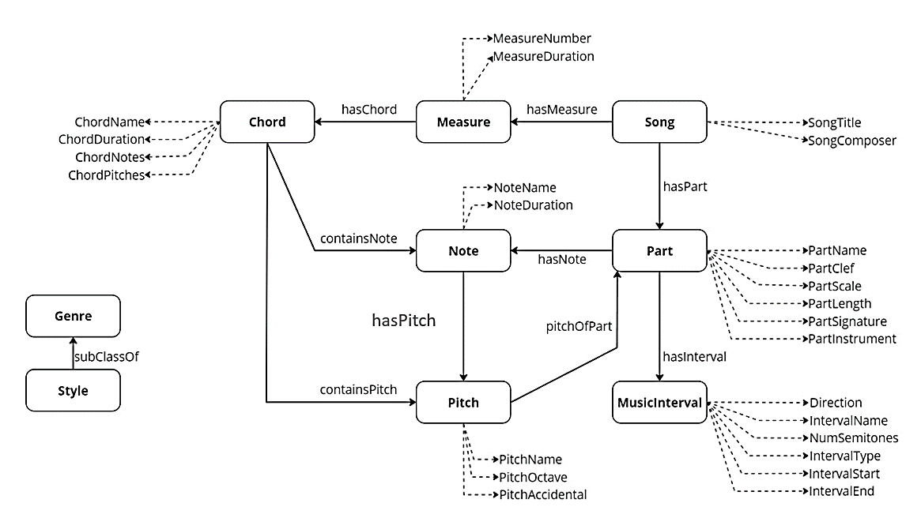
Ontology schema

Slide 5
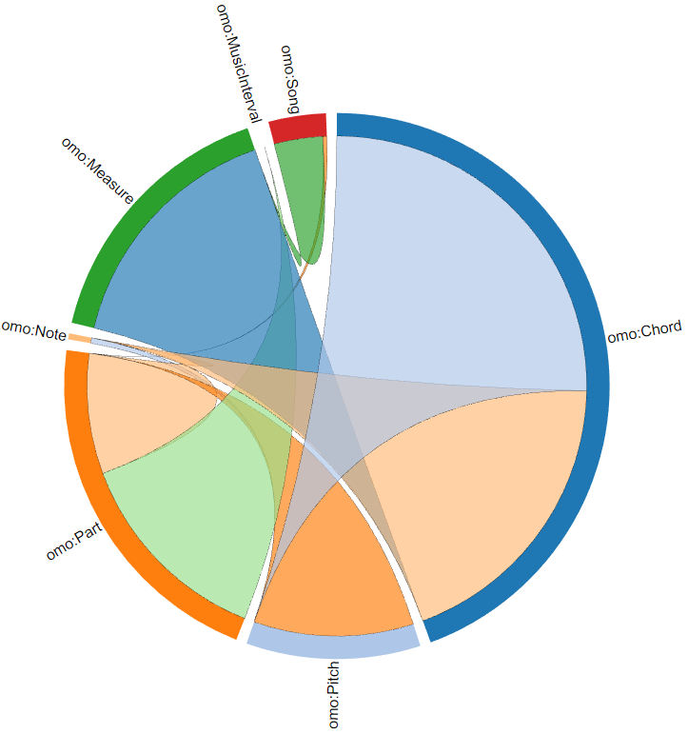
Relationships
Class | Relationships | Instances
omo:Chord | 111000 | 11076
omo:Pitch | 66000 | 645
omo:Part | 58000 | 488
omo:Note | 50000 | 112
omo:Measure | 35000 | 5742
omo:MusicInterval | 24000 | 1014
omo:Song | 6000 | 100
Graphic representation of relationships

Slide 6
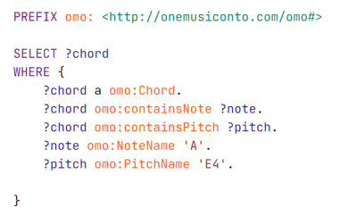
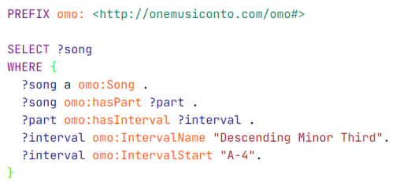
Chords extraction depending on a specific pitch and note
Song extraction depending on an interval with a specific start

Slide 7
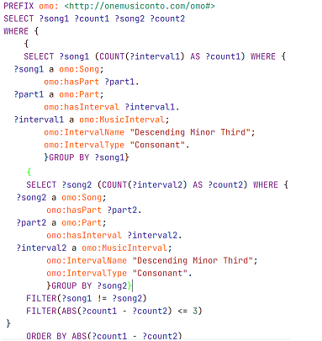
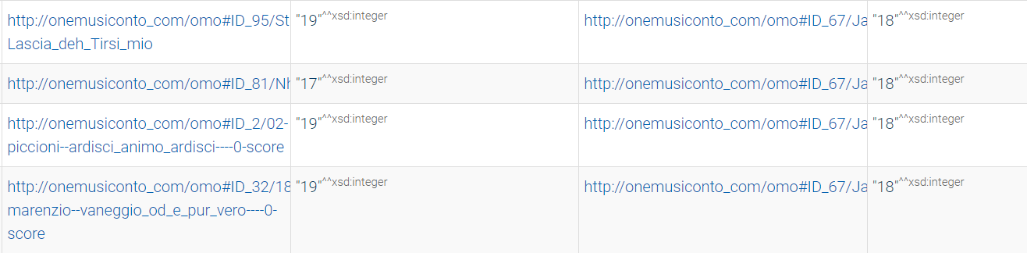
Extraction of two songs that contains almost the same number of a specific interval

Slide 8
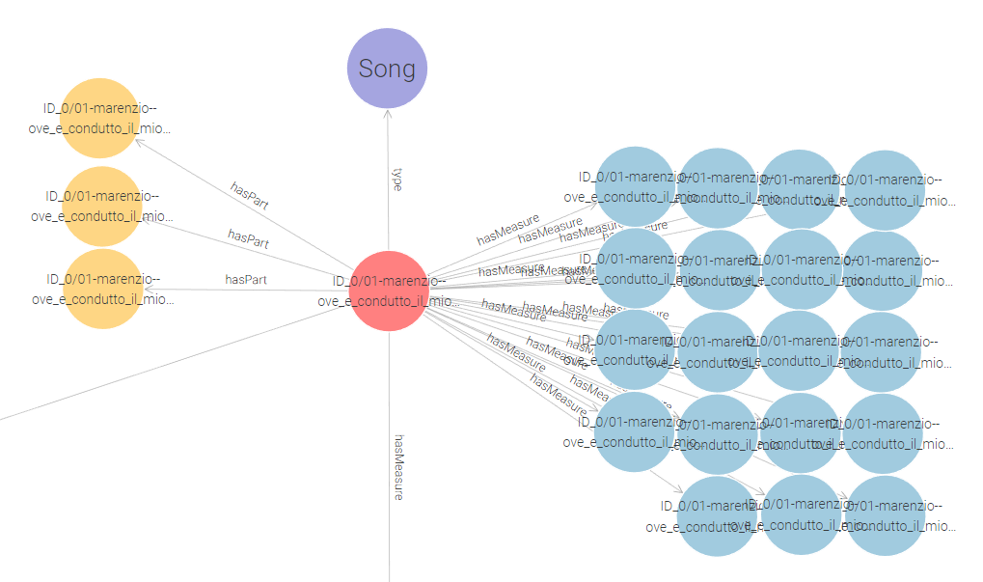
Song Expansion

Slide 9
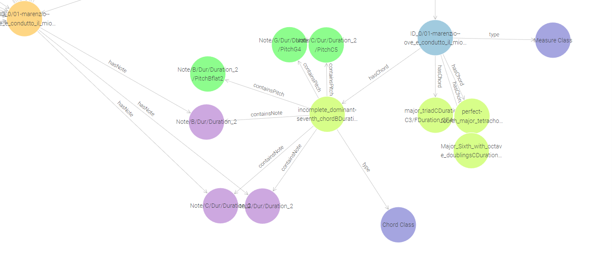
Measure and Chord expansions

Slide 10
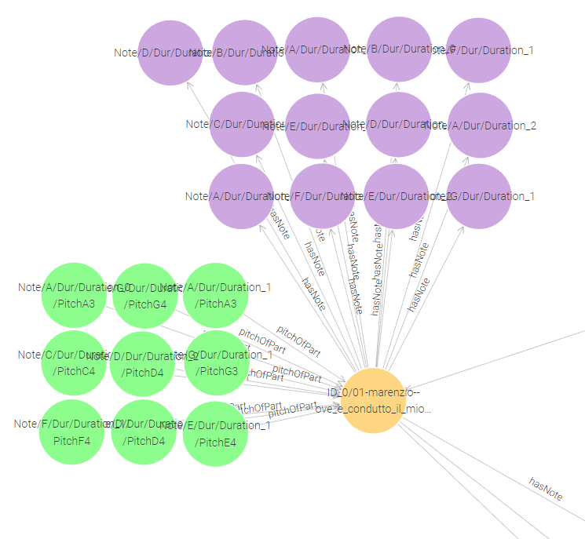
Part expansion

Slide 11
Conclusions
The ontology provides a detailed and organized representation of many aspects collected from music files
This type of data representation, offers the possibility to connect and correlate different musical entities
This approach allows for sophisticated querying and reasoning capabilities.

Slide 12
Future steps
RDF triples that represents musical data can have different applications in the field of music:
Study of music similarity
Extraction of song characteristics
Recommendation systems

Slide 13
Thank you for your attention

